Slide 1
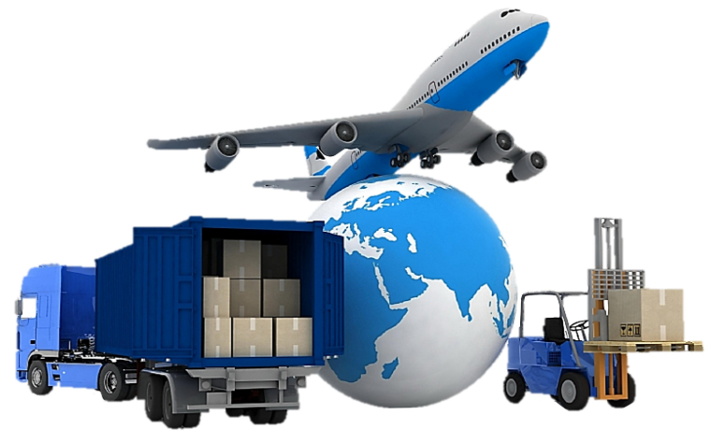

Slide 2
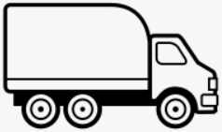
How the Logistics Supply chain process work:
Procurement
(Purchasing Products or Services)
Placing order with Vendor (indicates types, Products and prices)
Delivery completed (Product or Services delivered to the End user)
Logistics
Supply Chain
Surrati W/S (Storage of goods in good condition and delivered upon request)
Customer W/S (Direct delivered to end user W/S)
Material due date at vendor
Import License &
Import Permit should be available
Warehouse (W/S)
Shipping
(Via Air, Sea, Road)
Transportation (Deliver the goods in 48 Hrs within KSA at lowest price)
Clearance
( Dangerous or normal goods)

Slide 3
Surrati has a highly experienced and professional logistics team which offers full range of Logistics Solutions, Import Permits, Clearance of Dangerous Goods, Storage facilities, Transportation services and supply chain solutions to our customers.
Our Mission
Getting the right goods or services to the right place, at the right time and in the desired condition at the lowest cost and highest return on investment.
Our Innovation
We have been helping our customers get connected to the services they deserve through reliable, long-term solutions, while continuing to achieve new business milestones and growing with us.
Our Coverage
We provide first class service anywhere you need for your logistic needs by pickup or delivery. We provide moving solutions locally inter-province, intra-province and coast-to-coast logistic solutions across Saudi Arabia.
Our Delivery
We aspire to be a creative and innovative leader in transportation solutions, to transcend in the industry, and truly become an eminent business moving forward. Our goal is to continue to develop innovative and efficient processes and reach into new markets as a transportation company. We differentiate our solutions based on our in-depth customer understanding, strong focus on market needs.
Our Values
In everything we do, we strive to provide the best service available to you. We have an innovation approach, a focus on continuous improvement, and are a solutions driven company. Our company was started because we saw a need for an honest, innovative and dependable service provider, we have been fulfilling those needs ever since. Our reputation is paramount to us and we stop at nothing to prove that.

Slide 4
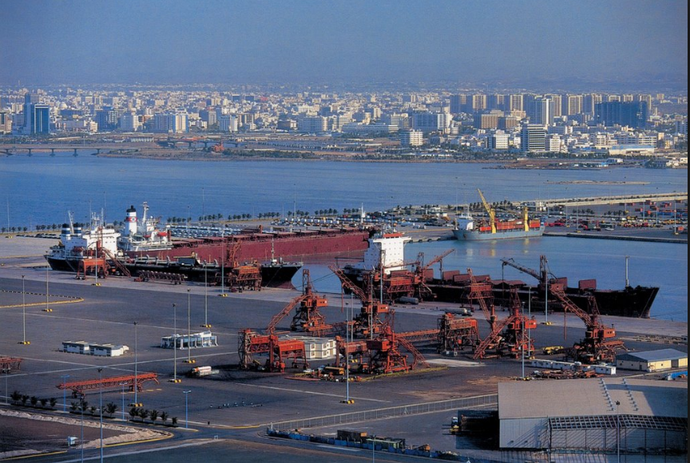

Slide 5
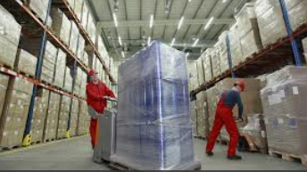
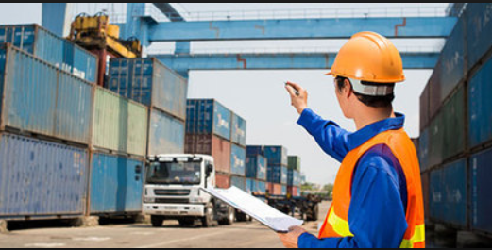
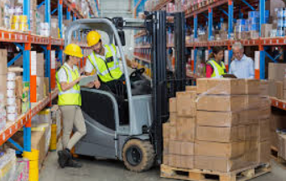
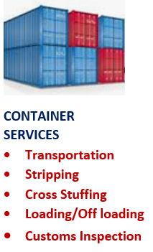
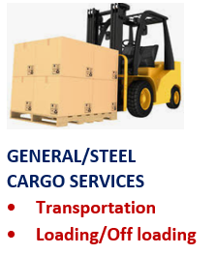
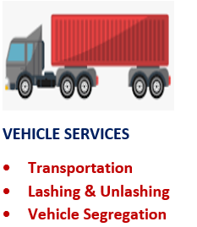
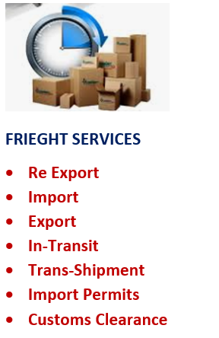
Our Services

Slide 6
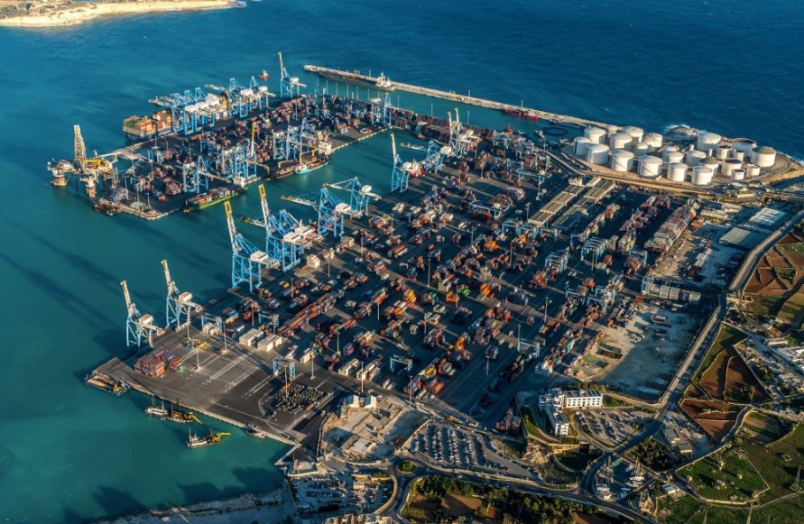
RSGT is located in the Kingdom’s first bonded and re-export zone which provides a thriving integrated logistics hub on the coasts of the Red Sea. Surrati creates significant operational synergy in cargo handling under the close cooperation with RSGT and offers customers seamless integrated logistics services from the sea-side to the land side.
Red Sea Gateway Terminal –Redefining Standards
Saudi Arabia’s latest state of the art container terminal redefining the efficiency of the container terminal and facilitating the growth of the Kingdom’s economy.

Slide 8
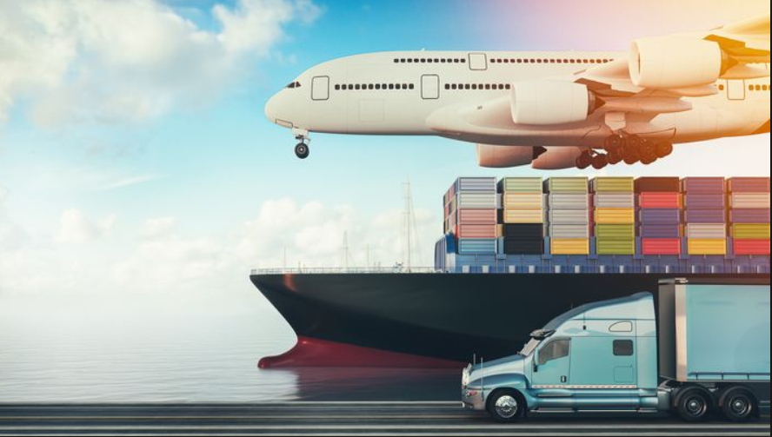
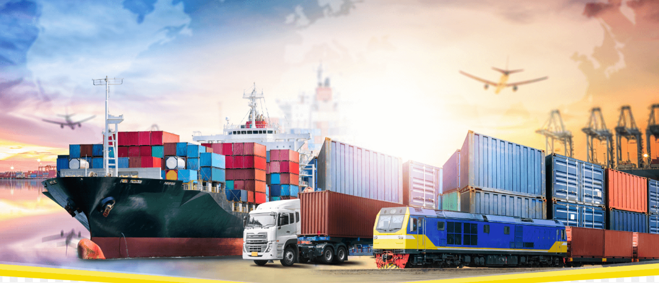
Surrati is your
integrated logistics
solution partner
of choice
THE ADVANTAGES OF SURRATI
Surrati provides your business with unparalleled access to market, world class infrastructure bonded and non-bonded solutions as well as dedicated investor support in a duty free and competitive operating environment.
We cater to all market verticals including trade, logistics and manufacturing. We endeavour to create value through the integration of our logistics zones and support services.

Slide 9
Surrati Logistics Solutions Thahliya street, Jeddah, KSA Tel: 012 675 8984
Mob:+966 542233286/546606805 Email: enquiry@surratiperfumes.com

